Slide 1

Tower Hopscotch Demonstration Group 5
Raphael Emberger
Stefan Bösch
Philipp Meier
Nicolas Eckhart

Slide 2
Contents
Project Management
Prototype State
Demonstration Tower Hopscotch
Future Prospects
Questions

Slide 3
Project Management
PM Breakdown – Tower Hopscotch
Inception Phase [E: 26hrs / S: 27.5hrs] | 25.09.2017 | 06.10.2017
Iteration #1 | Estimation: 26hrs | Spent: 27.5hrs
Elaboration Phase [E: 111hrs / S: 103hrs] | 09.10.2017 | 17.11.2017
Iteration #2 | Estimation: 34hrs | Spent: 31.5hrs
Iteration #3 | Estimation: 34hrs | Spent: 27.5hrs
Iteration #4 | Estimation: 43hrs | Spent: 43hrs
Construction Phase [E: 172hrs / S: 155.5hrs] | 20.11.2017 | 15.12.2017
Iteration #5 | Estimation: 74hrs | Spent: 72.5hrs
Iteration #6 | Estimation: 98hrs | Spent: 83hrs
Iteration #7 – Buffer week 18.12.2017 – 22.12.2017

Slide 4
Prototype State
Fully functional tower defense game with multiple layers that need to be managed simultaneously.
Exchangeable, dynamically loaded maps with multiple layers.
A multitude of enemies with unique stats and the ability to teleport between layers in certain situations.
Multiple towers that can interact with enemies on different layers and can be upgraded for improved range and firepower.
Retro 2D art assets adapted for each layer type.

Slide 5
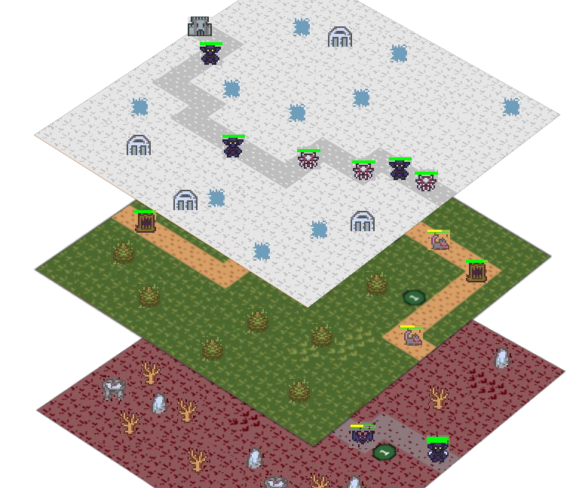
Demonstration

Slide 6
Future Prospects
Compose a fitting soundtrack for the games art style and add sound effects for different events.
Add animations for enemy movement and teleportation as well as improving the existing tower firing animation.
Add an in game map editor / manager so the player does not have to edit the map file manually.
Add more towers with different strengths to counter specific enemy types.
Long term: Move to a semi 3D user interface with the layers stacked instead of aligned horizontally.

Slide 7
Questions?

Slide 8
Thanks for your time!
Raphael Emberger
Stefan Bösch
Philipp Meier
Nicolas Eckhart

